Slide 1
Open API Hackathon 2022 THECODED_ecb4 A fundraising app to support content creators, students and fundraisers using MTN mobile money

Slide 2
Idea Title
A fundraising app to support content creators, students, and other fundraisers using MTN mobile money

Slide 3
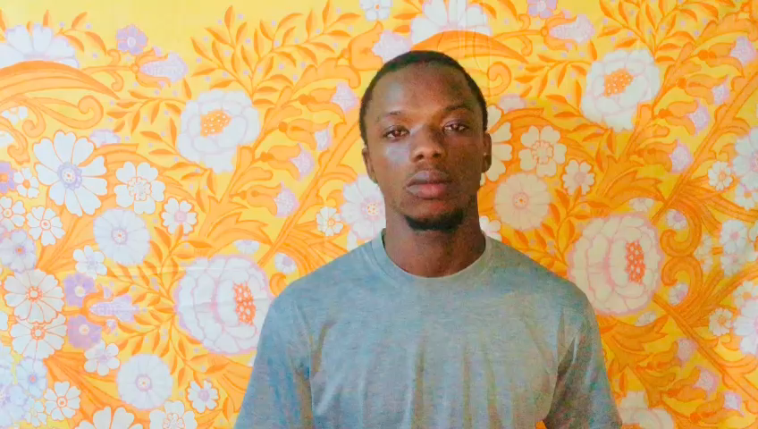

Slide 4



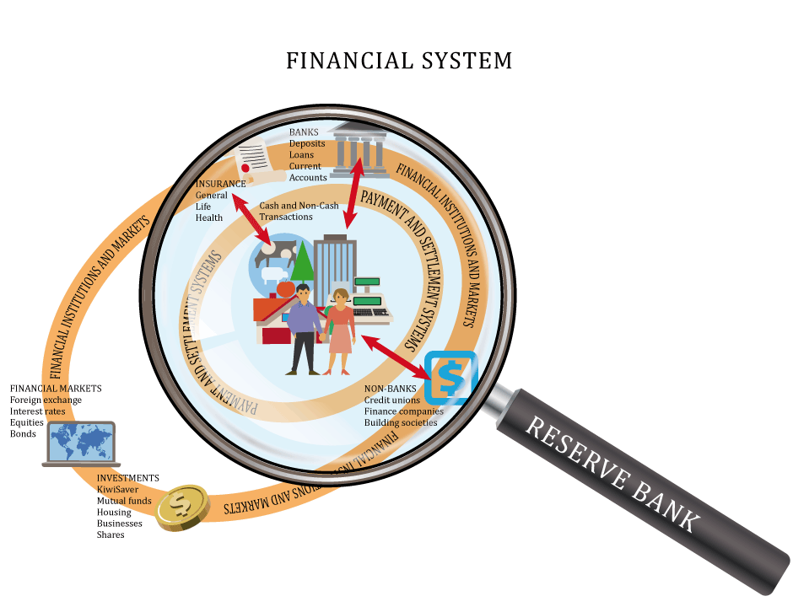

Fundraisers and supporters need a product that is meaningful and enjoyable to use
Problem Statement
Easy way of funding
Content creators, students
and fundraisers find it difficult to get enough funding due to how the payment method work
Ease of payment
A lot of people prefer easy momo transactions as compared to banks and credit cards
Getting a supporter
Fundraisers need an app that is ease of use.

Slide 5
Approach
Create a platform that will enable fundraisers to provide the necessary details to request funds or set up a fun base for their supporters to support them that will help them achieve their set goals.
Give content creators, students, and fundraisers the tools they need to capture and share their stories far and wide.
Easy funding using Momo payment integrations in the fundraising app

Slide 6
Business model
Target Market
Content producers (and their fan base) and similar people make up the majority of our target market (Religious bodies).
Revenue Stream / Monetization
Commission from users / Target customs ( 5% from content creators and other target customs, 2% from student )from Revenue goal / subscriptions.
Potential Customers
Content creators
Students
Religious Bodies
Individual fundraisers

Slide 7
Business model
Competition
There are several comparable platforms both inside and outside of Africa, but none of them address the issue of placing African content producers first. International platforms offer fantastic content creator support but inadequate payment and redraw support for African content creators. And many in Africa are more concerned about Africans living overseas. Furthermore, our Platform will allow for safe and reliable transactions inside Africa. And, as African content producers expand at a rapid pace, it is critical that we provide a platform where they may get assistance and generate exclusive material for their fans/supporters.

Slide 8
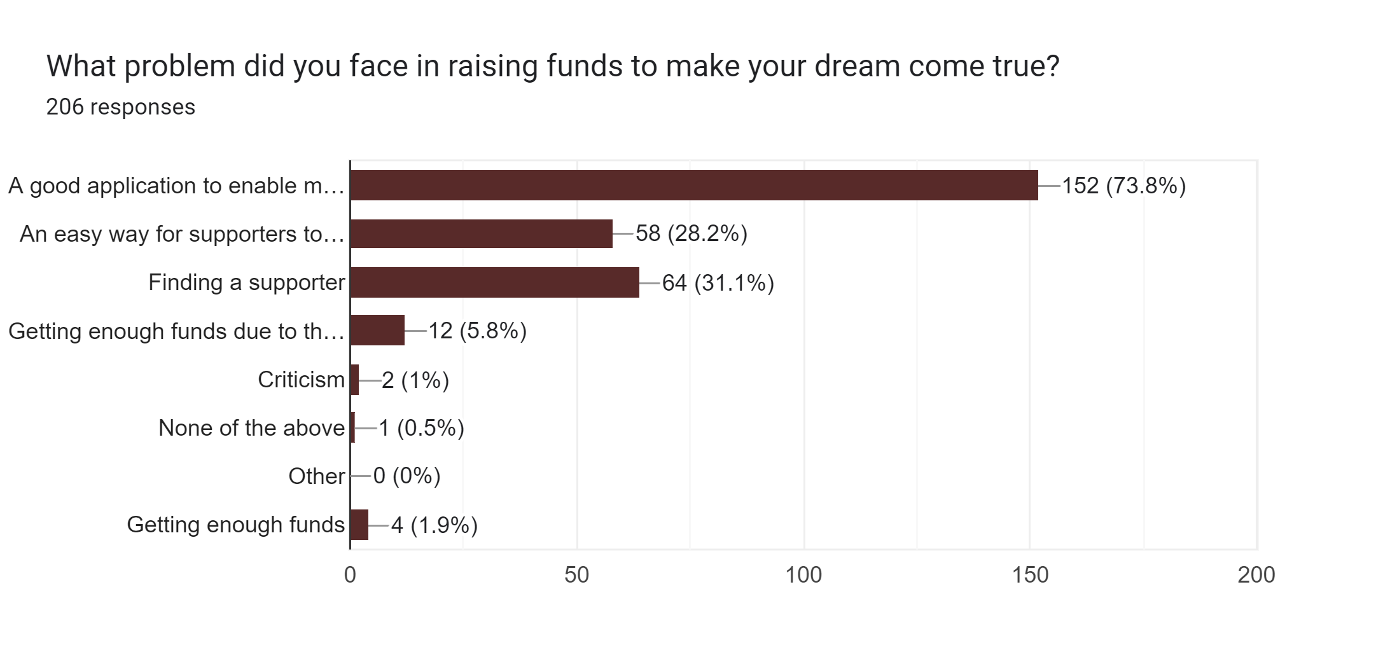
Other Data

Slide 9
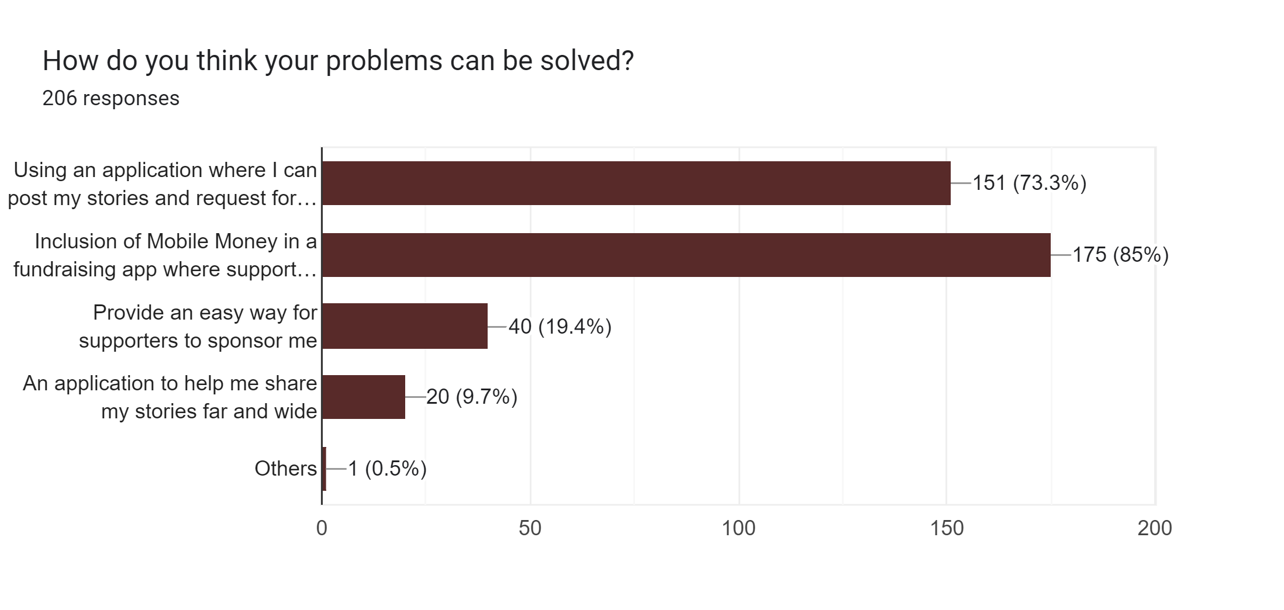
Other Data

Slide 10


Competitive advantage
COMPETITORS
COMPETITIVE ADVANTAGE
Usability
Momo payment integration
Support African fundraisers
Refunding policy
GofundMe
Patreon

Slide 11
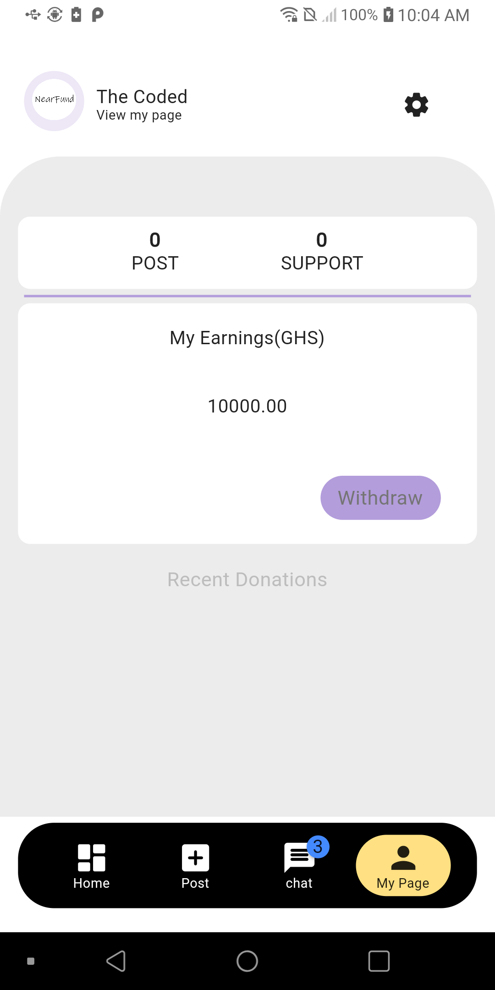
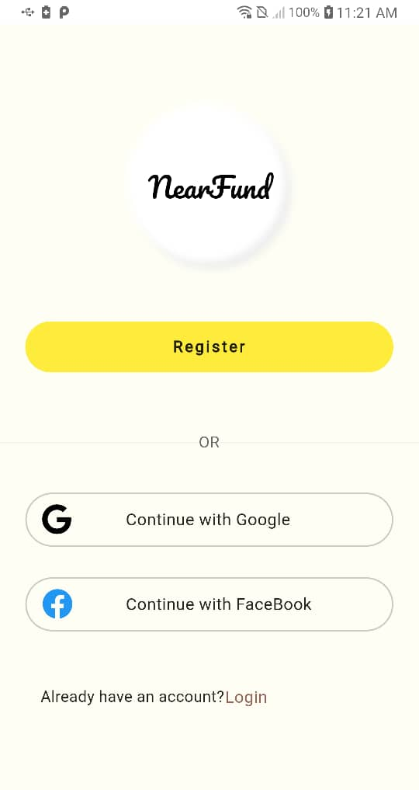
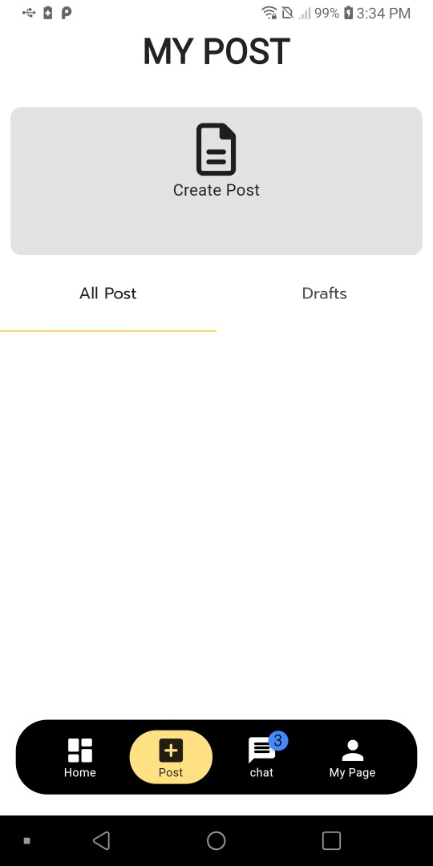
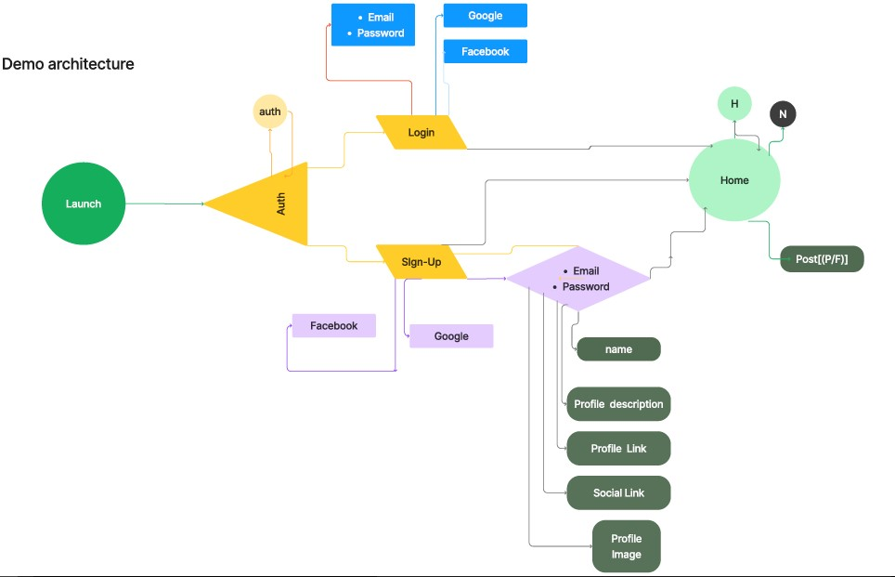
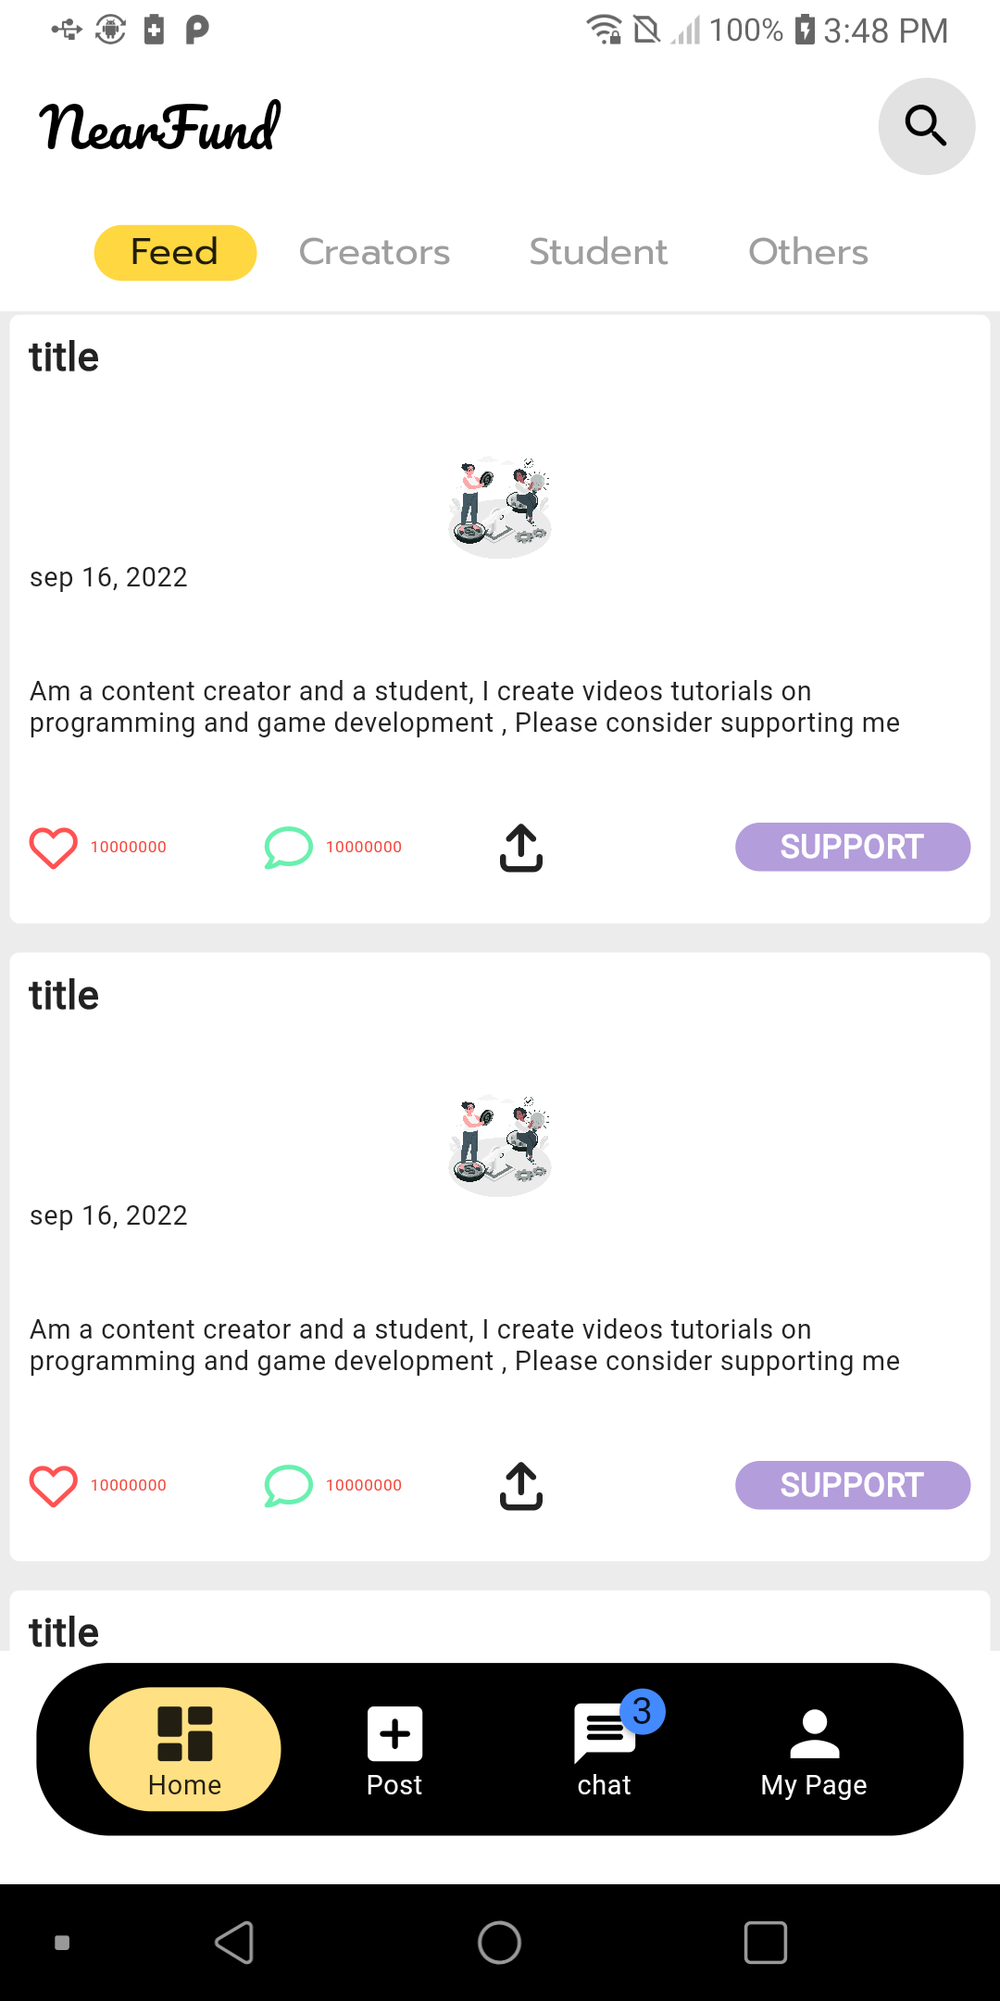
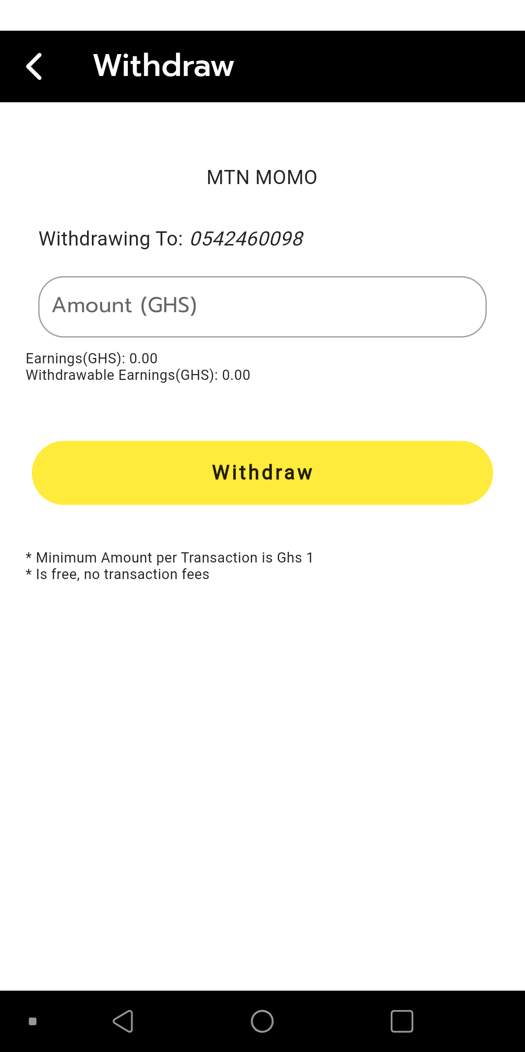
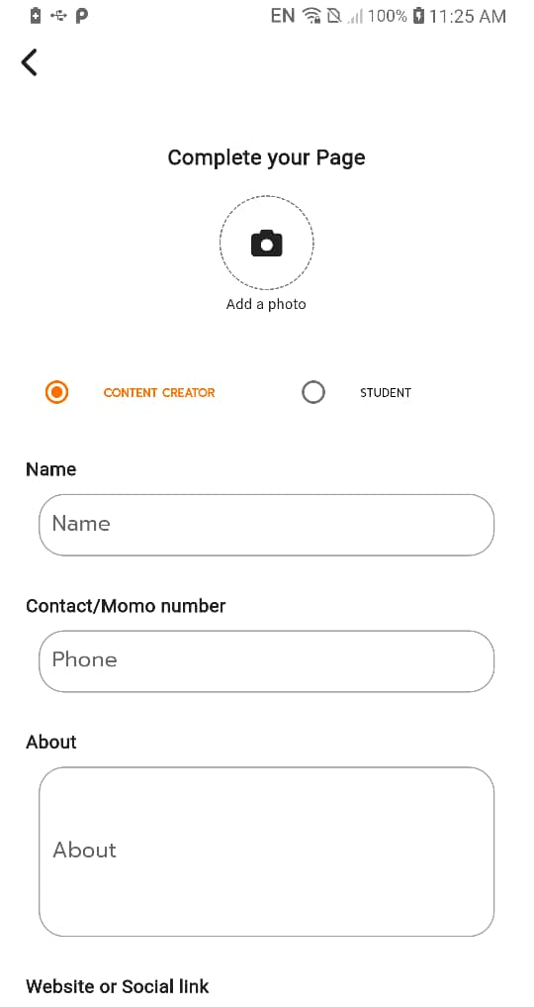
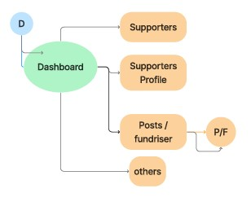
Solution Overview with a diagram

Slide 12
Thank you

